Slide 1
Doraemon Den- 2T
Group - 9
Team:
-Sohail Mulla
-Shreya Murarka
-Shruti Vatsa
-Siddharth Singhvi

Slide 2
Outline
Problem Statement
User Personas
Pain Points
Solutions
Wireframes
Metrics
Conclusion

Slide 3
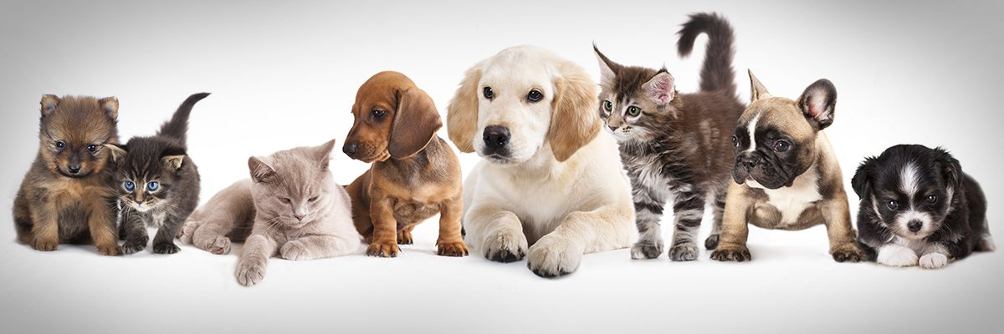
The Problem Statement
Design a mobile app for buying /selling/adopting pets for users in India

Slide 4


User Personas
Julia
Parent
Age :38 yrs, working , middle class, married , lives with in-laws
Goals :
A companion for the kid
Companion for elderly people
Pain Points:
Animal can make the house dirty increasing the workload
Distract the child from studies.
Increase in expenses (Healthcare costs for pets)
Rahul
Teenager
Age :18 yrs , middle class , Male,student,unemployed
Goals:
Search for good quality breed
flaunt on social media.
Become center of attraction
Pain Points:
Taking care of pet
Expected breed to adopt is rare
Affects studies and extracurrics
Nuisance to the neighbours/outsider

Slide 5

User Personas
Jasprit
Middle age businessman
35 yrs, unmarried, pet store owner, Animal lover,
Not so tech savvy
Goals:
Profit & Maximize sales
Acquisition of rare species of pets
Expand market reach
Understand the user demand better
Pain Points:
Difficulty in operating the applications
Brand reach limited geographically
Transportation problems in online transactions
Doubts about online payment
Outreach is not good
Aakash
NGO worker
26 year old , Middle class , Graduate,works for NGOs
Goals :
Promote adoption of pets and stray animals
Creating awareness about animal rights
Pain Points:
People are pessimistic about adopting stray animals due to hygiene issues
Doesn’t have a platform to put forth his thoughts
Finding credible clients for adoption

Slide 6
Pain Points
Taking care of pets (like health care)
Expected breed to adopt is rare
Difficulty in operating and understanding the app functions
Outreach is not good

Slide 7
Solutions/Product Requirements
Outreach is not that good
Difficulty in operating and understanding the app functions
High Expense and taking care
Introducing a platform for updating the users regarding buying/selling/adoption of pets.
An additional explore tab in the app to post about interactive sessions, create blogs (inform people about sensitive topics, share their journey and interests), articles and share their views regarding the animals.
Can Provide a per month expenditure for each breed.
Recommend counsellor/vet for timely checkup of the animals to the owners.
Can mention the eating habits and medical specification of the particular animal.
Create a dashboard for keeping a check on vaccination record of the pets/animals and giving extra points/coins in return for each vaccine or health checkup.
Adding a small tutorial of the functioning of the app after signing in.
Simple UI

Slide 8
Prioritisation
Feature | Impact |  |  | Cost |  |  | Overall Weights
 | Feature value - 50% | Reach - 30% | Ease of use - 20% | Dev Time - 50 | Additional monetary costs - 40 | External Risks - 10
Explore tab | 1 | 3 | 3 | 1 | 1 | 3(any sensitive content shared) | 0.8
Vaccine dashboard | 2 | 1 | 2 | 3 | 2 | 1 | -0.7
Recommendation of counsellor/vet | 3 | 2 | 1 | 2 | 3 | 2(fraud deals) | 0.2
Note- Ranking order 1<2<3

Slide 9
Metrics to Track
No. of posts created
No. of views on each post
Likes & comments on the posts
Stakeholders:
Buyers/Adopters
Sellers
Counselors/Vets
Platform
Goal: Tracking metrics of Explore tab
No. of people registering for various activities/sessions via our app
No. of people visiting the explore section per day
Time spent on the app after adding explore tab
Conducting Weekly survey

Slide 10
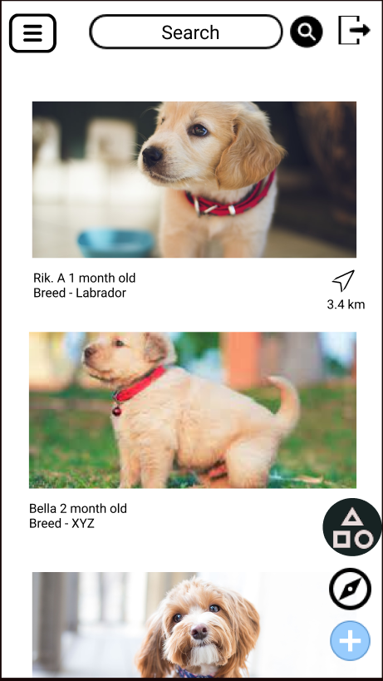
Homepage
Shows ads and posts by sellers and adoption agencies/NGOs.
Search bar on top provided
Various floating action buttons like explore,categories,add post at bottom right.
WIREFRAME

Slide 11
Categories Tab
Pets sorted into different categories so as to make it easier for the user to navigate and find their choice/breed of pet.
WIREFRAME

Slide 12
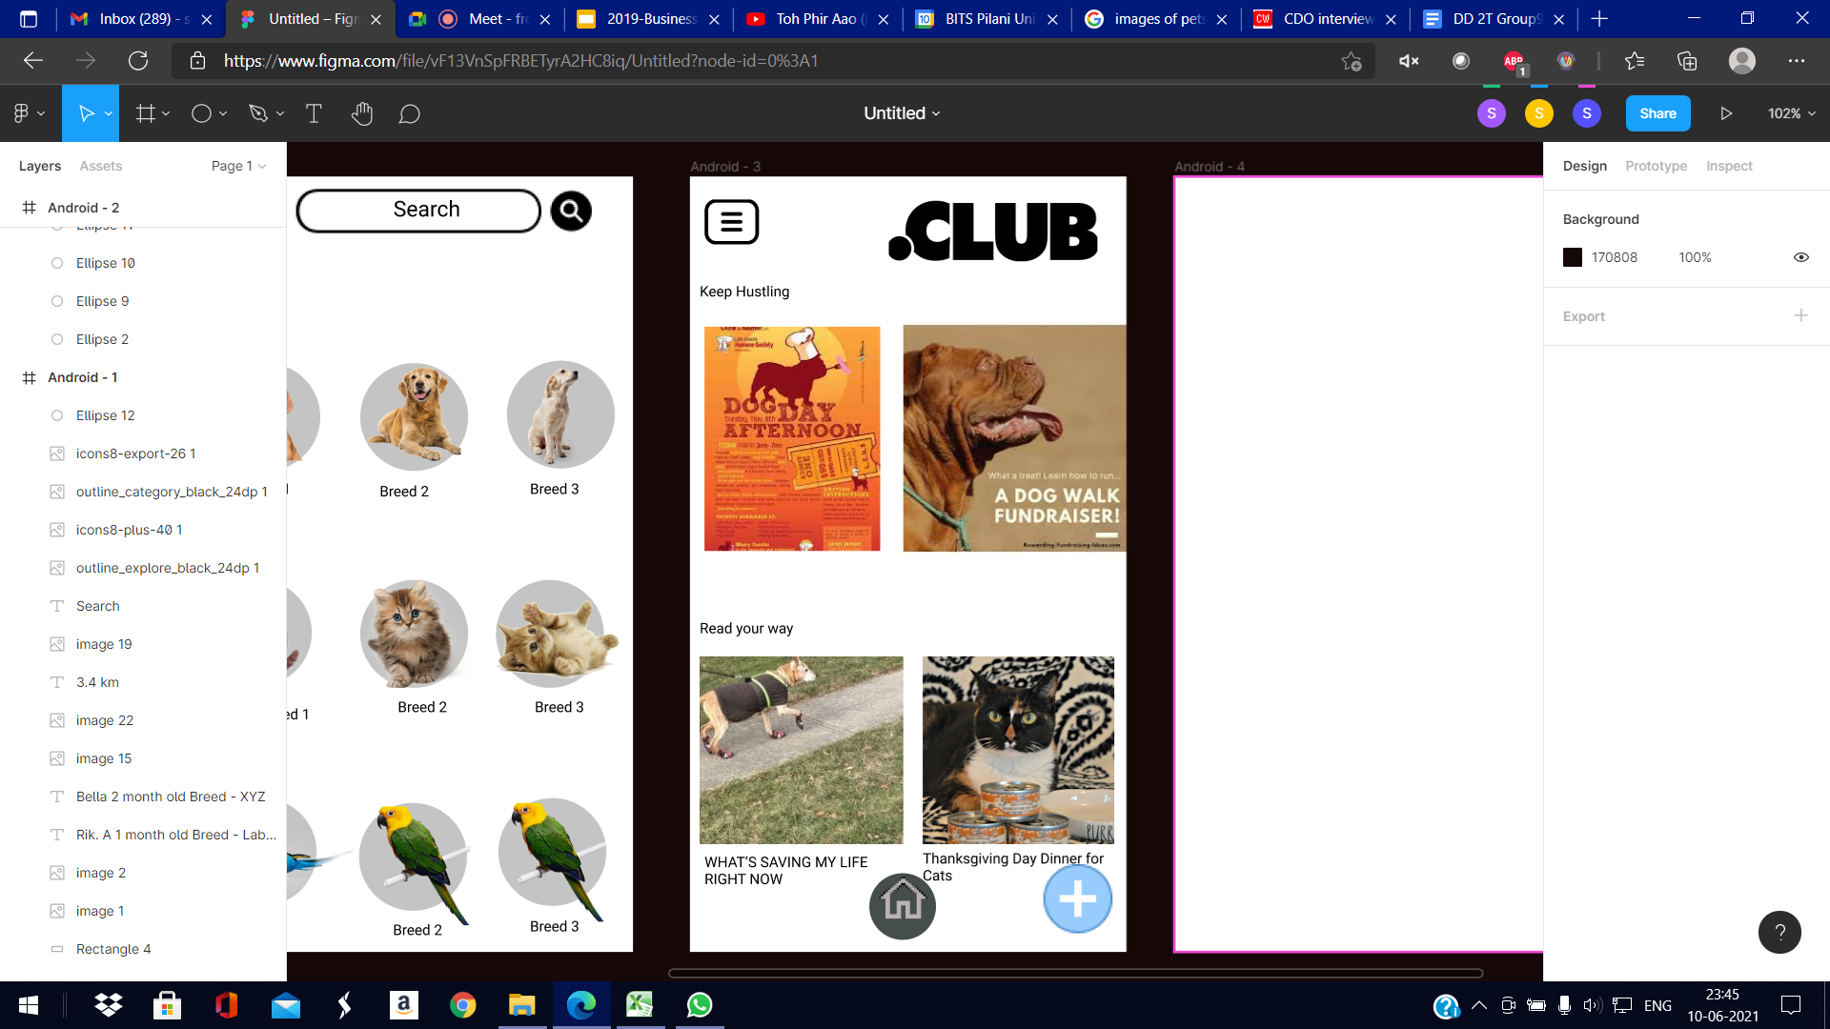
Explore Tab
Unique feature of our app
A platform for professionals , content creators and health experts to post blogs and articles related to pet rearing and general posts about events related to adoption camps,etc.
WIREFRAME

Slide 13
Conclusion
Our app is based on the mission statement: “Making the process of finding your soul-pet seamless”
We did the persona research from the point of view of both sides of users i.e. the buyers/adopters and the sellers. After going through the pain points carefully we narrowed down our solution to three features:
Explore tab
Vaccination and Pet care dashboard
Counsellor/Vet recommendation section
We chose the solution “Explore tab” for wireframing on the basis of Prioritization table calculations.
Some of the key features of explore tab includes:
Users can post about interactive sessions (fundraisers, pet competitions, etc.)
create blogs (inform people about sensitive topics, views)
Post articles regarding adoption camps or NGO activities.
Our app provides some unique solutions to promote a fulfilling experience for users along with promoting well-being of the animals and their rights.

Slide 14
Thank You!!

